Slide 1
RUHR-UNIVERSITY
FACTS & FIGURES

Slide 2

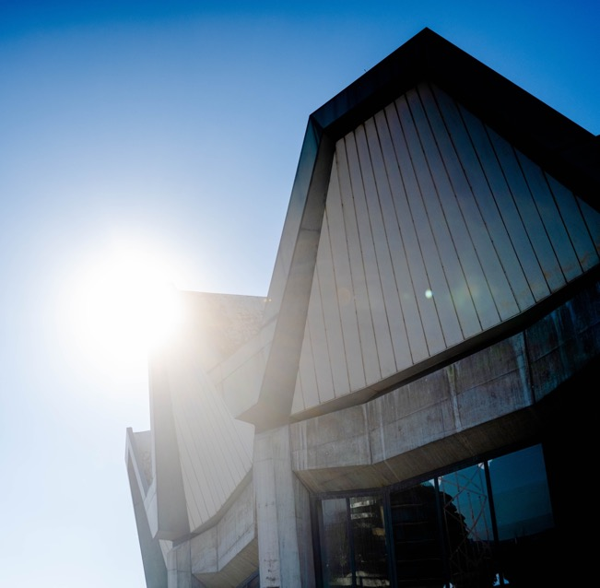
PROFILE
    Established as the first new university
    in the Federal Republic of Germany
    Inauguration in 1965
    Founded as a reform university
    Today one of the 10 largest German universities
    Powerful and optimally networked
    research hub
    Cutting-edge research linked to
    research-oriented teaching

Slide 3
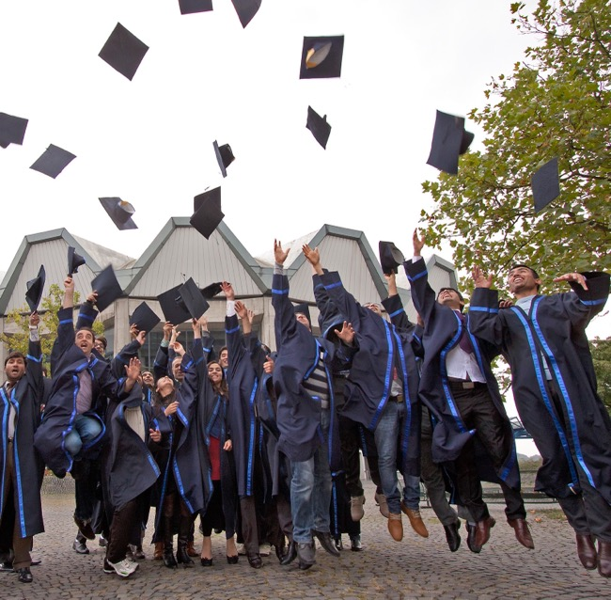
FACTS & FIGURES
STUDENTS & COURSES
    41,609 students
    6,864 foreign students
    3,846 PhD students
    764 international PhD students
    195 degree programmes
    17 double and joint degree programmes
Notes:
Neben den zentralen Handlungsfeldern einer Universität – Forschung, Lehre und Transfer – fokussiert sich das Rektorat auf die dargestellten strategischen Handlungsfelder.

Slide 4

FACTS & FIGURES
BUDGET: POWERFULLY POSITIONED
658
THIRD PARTY FUNDING
Mio.€
170
AMOUNT OF TOTAL FUNDS
Mio.€

Slide 5

FACTS & FIGURES
STAFF & FACULTIES
    6,360 employees
    500 professors
    21 faculties
    Comprehensive university with all academic disciplines:
      Humanities
      Social Sciences
      Engineering Sciences
      Natural Sciences
      Medicine
Notes:
Neben den zentralen Handlungsfeldern einer Universität – Forschung, Lehre und Transfer – fokussiert sich das Rektorat auf die dargestellten strategischen Handlungsfelder.

Slide 6

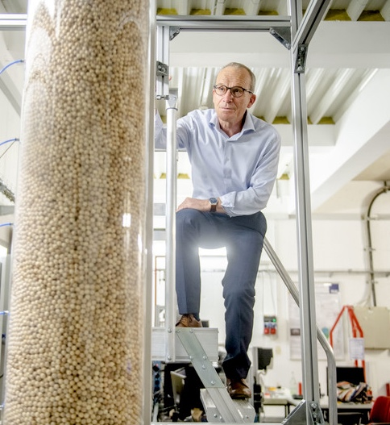
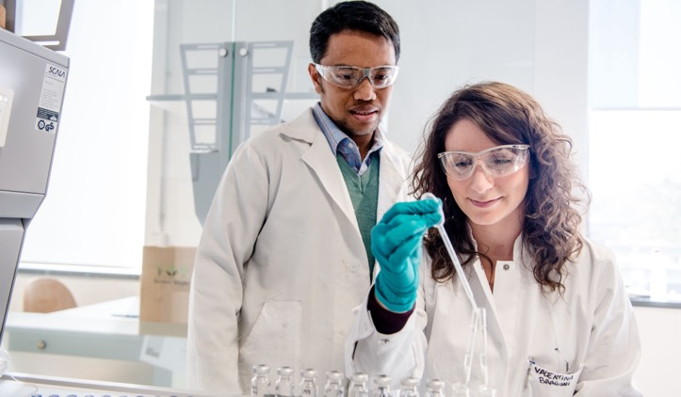
RESEARCH
Characterised by interdisciplinarity, collaboration and networking!

Slide 7

SCIENTIFIC FOCUS AREAS
Projects in 9 Research Departments
    Solvation Science
    IT Security
    Neuroscience
    Materials Research Department
    Center for Religious Studies
    Protein Research Department
    Plasmas with Complex Interactions
    Subsurface Modeling and Engineering
    Closed Carbon Cycle Economy

Slide 8
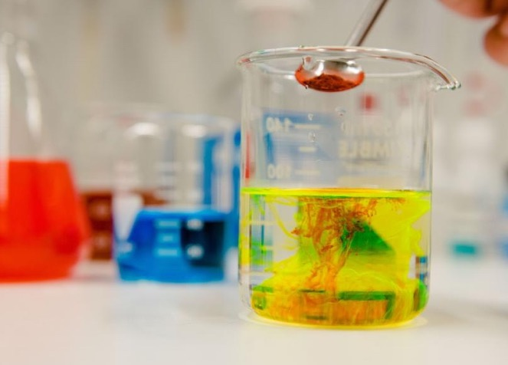

NATION-WIDE CLUSTERS OF EXCELLENCE:
FUNDED BY THE GERMAN EXCELLENCE STRATEGY
RESOLV
CASA
RUHR EXPLORES SOLVATION
CYBER SECURITY IN THE AGE OF LARGE-SCALE ADVERSARIES
Funded since 2012
Funded since 2019
Notes:
Neben den zentralen Handlungsfeldern einer Universität – Forschung, Lehre und Transfer – fokussiert sich das Rektorat auf die dargestellten strategischen Handlungsfelder.

Slide 9

RESEARCH
ALLIANCE RUHR
World class research on global challenges:
    Health
    Sustainability
    Digitalization
    Energy
    College for Social Sciences
    and Humanities
    together with the University Duisburg Essen
    and Technical University Dortmund
Funded with 75 Mio. € by the state of North Rhine-Westphalia!
Notes:
Neben den zentralen Handlungsfeldern einer Universität – Forschung, Lehre und Transfer – fokussiert sich das Rektorat auf die dargestellten strategischen Handlungsfelder.

Slide 10
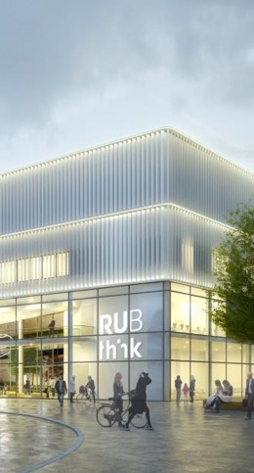
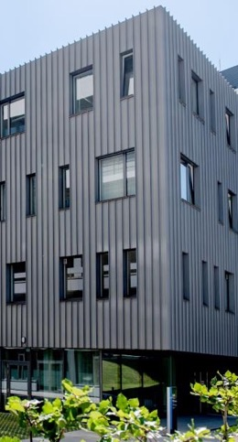
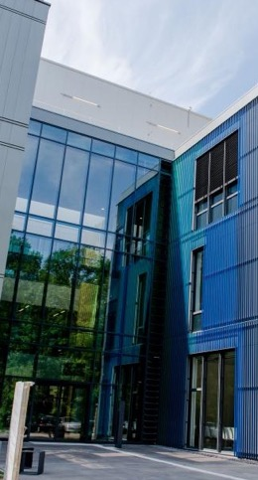
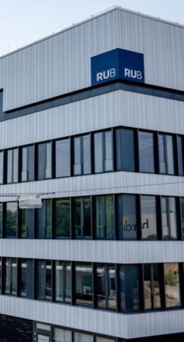
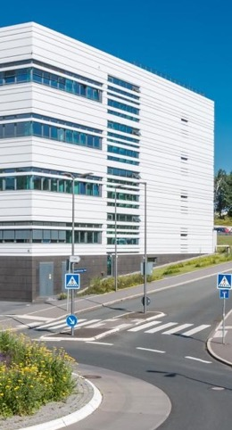
RESEARCH BUILDINGS
LEADING LIGHTS
Funded by the Federal Government and the State of North Rhine-Westphalia:
amounting to 250 million euros to date!
Designed to improve the infrastructural conditions at higher education institutions in Germany.
THINK
ZGH
ZEMOS
ZESS
PRODI
Notes:
Neben den zentralen Handlungsfeldern einer Universität – Forschung, Lehre und Transfer – fokussiert sich das Rektorat auf die dargestellten strategischen Handlungsfelder.

Slide 11

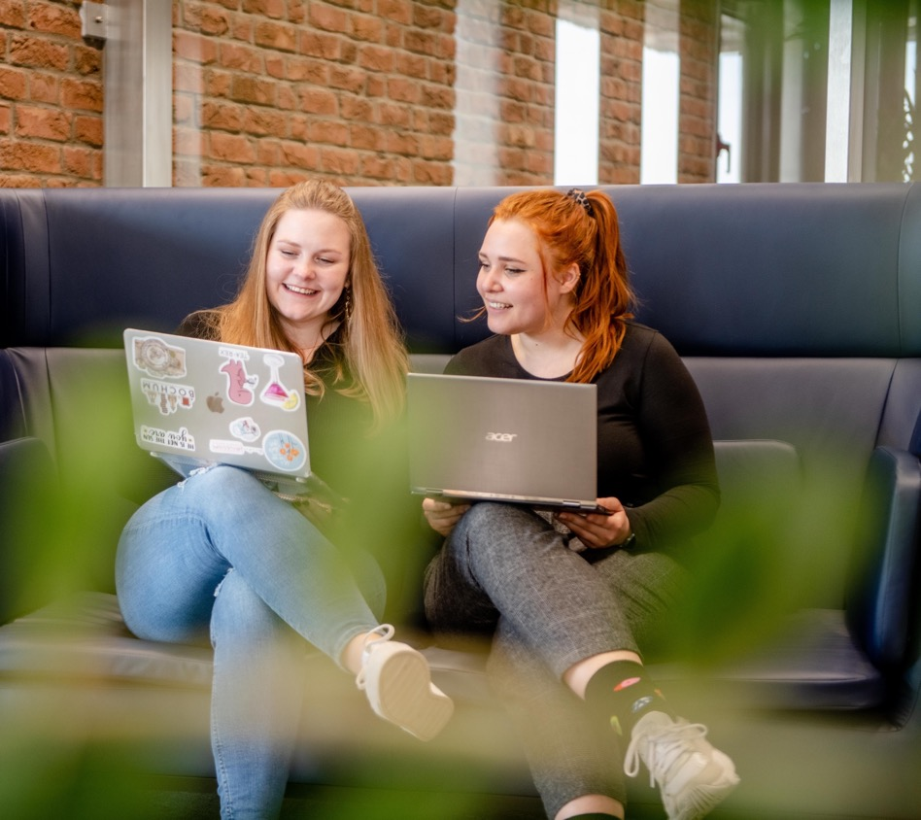

LEARNING & TEACHING
To learn, to live, and to achieve together

Slide 12

GUIDING PRINCIPLE:
RESEARCH-ORIENTED L&T
    Step by step introduction to and involvement
    in current research starting at the bachelor level:
      critical and self-critical thinking
      independent thinking and acting
      academic values and social responsibility
      interdisciplinary and teamwork
      science communication …
    Integrated research modules in all programs
    Annual program for research-oriented L&T development
    Didactic Support for research-oriented L&T

Slide 13

MISSION:
TO LEARN, TO LIVE, AND
TO ACHIEVE TOGETHER
    Students actively involved in the
    development of L&T:
    Active student participation in boards and
    commissions
    Annual program for student-initiated courses
    Internationalization by Cooperation:
    The European University of Post-Industrial Cities (UNIC)
    Professional School of International Education (PiStE)
    Towards a Europan Syllabus of Teacher Education
    (TESTEd)

Slide 14
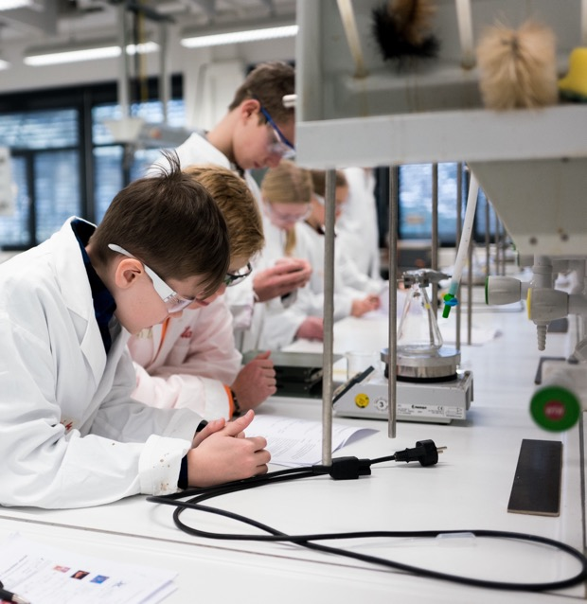
MISSION:
TO LEARN, TO LIVE, AND
TO ACHIEVE TOGETHER
    Important Institutions for the
    development of L&T:
    RUB L&T Center (ZfW)
    Professional School of Education (PSE)
    Key Competences Division (Optionalbereich)
    Language Centers (ZfA + LSI): 15 languages
    School Students‘ Laboratories:
    80 courses / 1,400 students per year

Slide 15

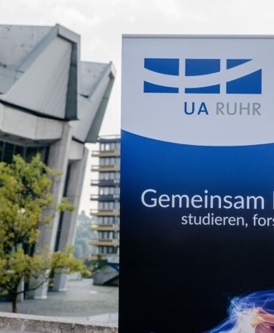
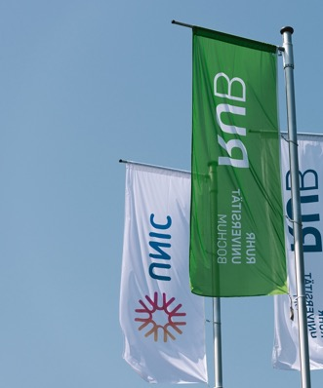

BROADLY NETWORKED
CROSS-DISCIPLINARY
AND CROSS-GENERATlONAL
Setting new standards
in research, education, the promotion of early career researchers, transfer and social responsibility.
Strategic partnerships as long-term collaborations
LOCAL
REGIONAL
EUROPE
WORLDWIDE
UNIVERCITY
UA RUHR
UNIC
WUN
Notes:
Neben den zentralen Handlungsfeldern einer Universität – Forschung, Lehre und Transfer – fokussiert sich das Rektorat auf die dargestellten strategischen Handlungsfelder.

Slide 16
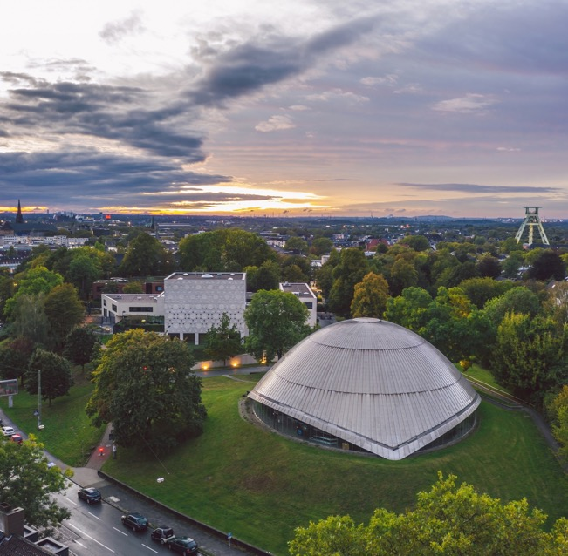
UNIVERCITY BOCHUM
Cooperation in the “City of Science” Bochum
    UniverCity Bochum is a unique format of
    science cooperation in Germany
    Partners: the city of Bochum,
    seven universities represented in Bochum,
    two national research institutes and others
    Focus on transfer topics, knowledge-based urban development and cooperation and outreach to society
Total amount of students in Bochum: 53,000!

Slide 17
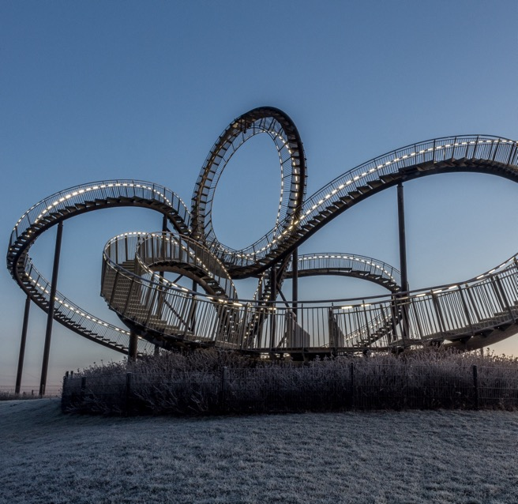
UNIVERSITY ALLIANCE
RUHR
Cooperation at Germany’s largest
academic hub:
    RUB, TU Dortmund and
    University of Duisburg-Essen
    open gateway to the Ruhr region
    more than 120,000 students,
    of which 19,000 are international
    over 9,000 researchers
    role model for cross-institutional
    and cross-city cooperation
Research Focus bundled in 5 topics (see below …)

Slide 18
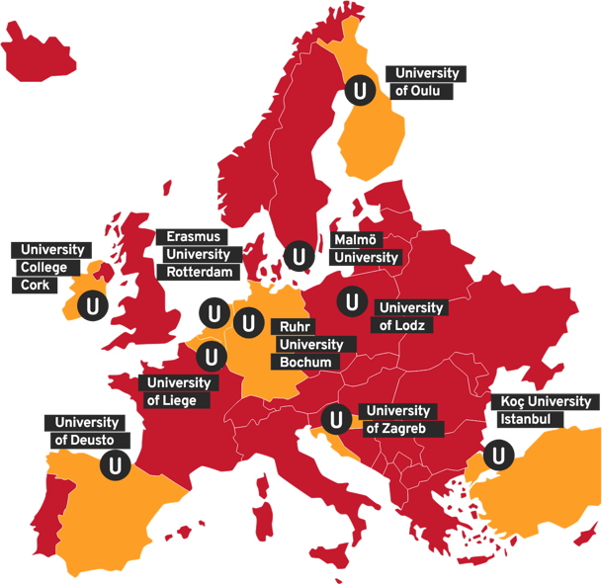
THE EUROPEAN UNIVERSITY OF
POST-INDUSTRIAL CITIES: UNIC
Cooperation in a European university network
    international consortium of 10 universities,
    located in 10 post industrial European cities
    Aims:
      increase of student and staff exchange
      Cooperation in teaching, research and transfer
      Co-production of knowledge in CityLabs
      Citizens‘ and cities‘ direct involvement in research
      Key impact areas: Virtual Exchange,
      Diversity Education, Urban Studies/Development,
      Engaged Research

Slide 19

WORLDWIDE
UNIVERSITIES
NETWORK
Cooperation with like-minded partners
    24 universities, 6 continents
    renowned international network
    socially relevant research with a focus on the global Sustainable Development Goals (SDGs)
    fostering the next generation of dedicated scientists
    network of full universities: all scientific disciplines at RUB can benefit

Slide 20

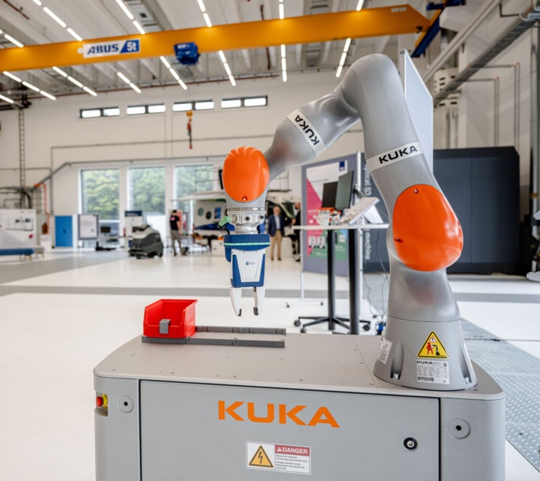
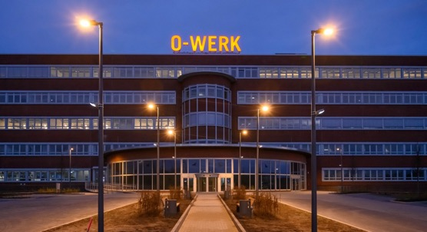
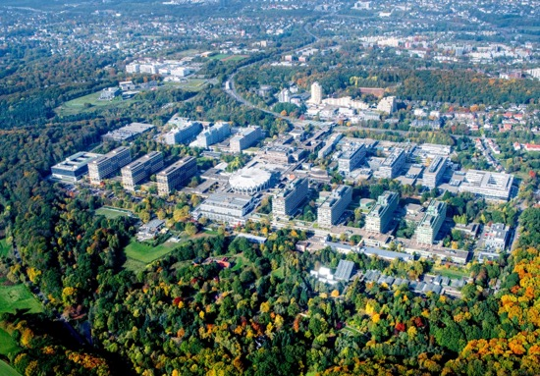
TRANSFER
Third core task of the university, alongside reasearch and teaching.

Slide 21
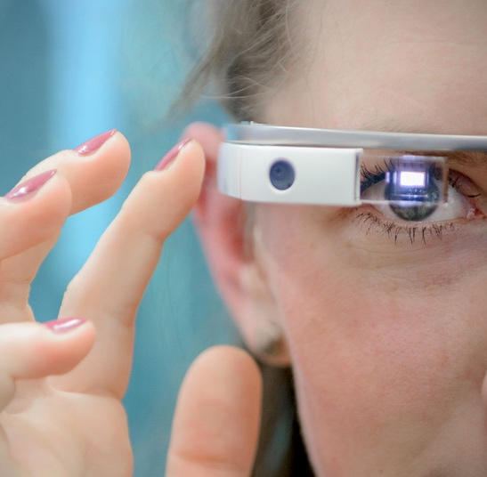
INDUSTRY & SCIENCE
RUB paves the way for ongoing exchange
    WORLDFACTORY Start-up Center (WSC)*
    Nurturing entrepreneurship at an early stage
    Fostering students’ entrepreneurial abilities
    Competent consultancy and assistance for investors and company founders
    Assisting patent applications
    Comprehensive further education programme
    at “Akademie der RUB”
*WSC funded with more than 20 Mio. € by the state of North Rhine-Westphalia!

Slide 22

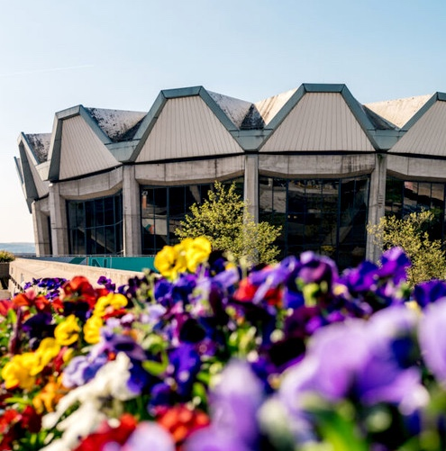

STRATEGIC
TOPICS
CROSS-CUTTING ISSUES
Sustainability, Diversity,
Internationalisation …and Digitalisation!

Slide 23
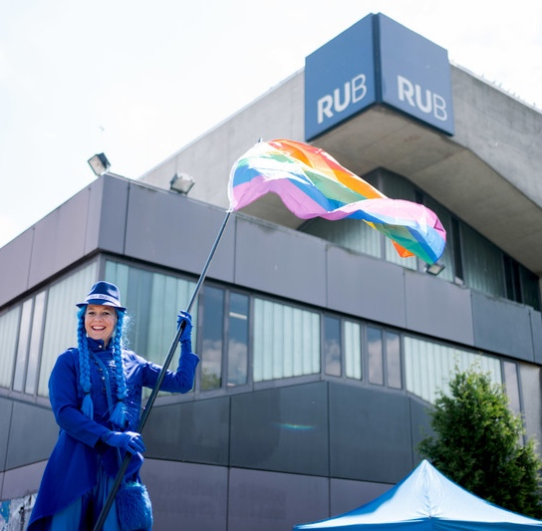
DIVERSITY
Diversity is RUB’s greatest strength!
    Making Diversity visible
    Combating any kind of discrimination
    Promoting talent
    Spirit of mutual appreciation and respect
    Equal opportunities in research, study and administration
    Family-friendly
Audit "Shaping Diversity" 2022-24 by Stifterverband

Slide 24
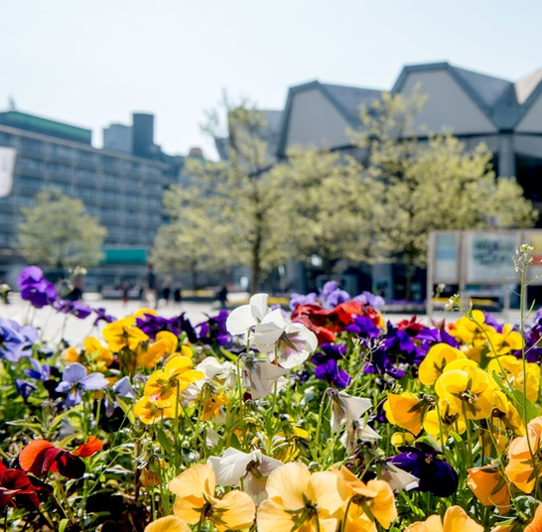
SUSTAINABILITY
Tangible commitment
    Sustainable campus development
    Sustainability as a major objective in the upcoming years
    Mission Statement: Sustainable RUB 2030
    Sustainability Think Tank and Task Force
    Campus-wide Sustainability Office
    Expert and sustainability officer of the rectorate: Prof. Dr. Andreas Löschel
Sustainability is one of six fields of action stipulated by the university development plan!

Slide 25

DIGITALIZATION
New avenues for teaching, research and
administration
    Integration of Artificial intelligence in higher education (chances vs. challenges)
    Fascilitation of organization of student lifecycle (from enrolment to diploma to alumni support)
    New, lean administration processes
    In-depth research of effects, chances, risks, digitalization in different academic fields
    CIO: Prof. Dr. Andreas Vogel
Digital technologies render research, education, study, and administration more flexible, structured and simple!

Slide 26

INTERNATIONALISATION
Progress through international networks
    University-wide partnerships + Global Engagement
    Scientific cooperation agreements
    More than 350 Erasmus partner universities throughout Europe
    Transnational university cooperations
    Welcome Centre for international researchers
    International Student Services for students
    University Without Borders: assembles all project with and outreach to refugees and
    scholars or students at risk
Permanent international exchange with universities, research institutes and networks!

Slide 27
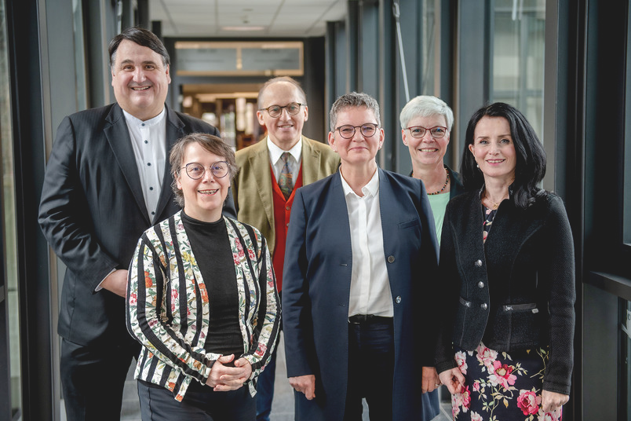
ReCtoratE
Vice-Rector for Academic Affairs:
Prof. Dr. Kornelia Freitag
Vice-Rector for Diversity,
Inclusion and Talent Development:
Prof. Dr. Isolde Karle
Vice-Rector for Structure,
Strategy and Planning:
Prof. Dr. Denise Manahan-Vaughan
Vice-Rector for Research and Transfer:
Prof. Dr. Günther Meschke
Chancellor:
Dr. Christina Reinhardt
Rector:
Prof. Dr. Dr. h. c. Martin Paul

Slide 28

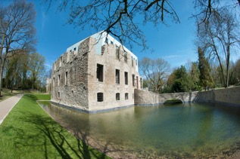
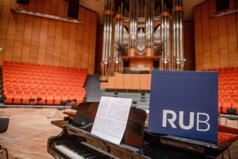
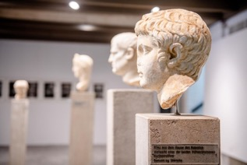
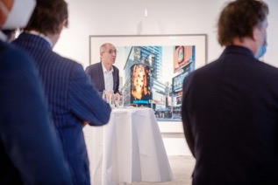
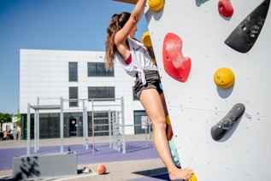
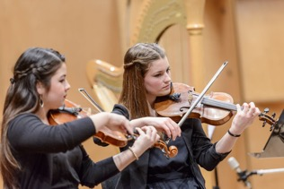
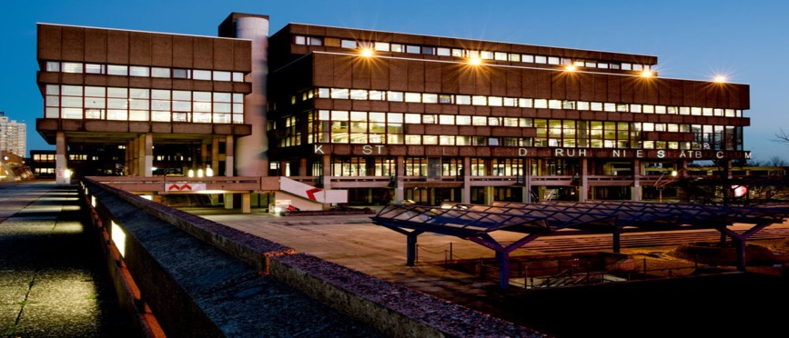
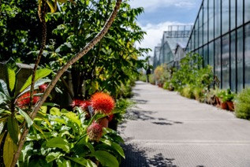
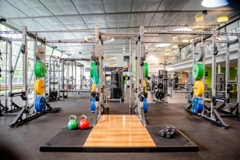
CULTURE,
RECREATION
& MORE
Arts, sports, concerts, nature.

Slide 29
Endfolie

